Slide 1
Capstone Project- The To-Do Tracker
Rohini Haravi Srihari Kurapati
Siddhesh Kulkarni

Slide 2
What is To-Do Tracker?
To-Do Tracker helps you to accomplish a set of tasks in order to achieve a goal wherever you are. In today’s world, many of us, use apps on our phones to manage our tasks. To-Do Tracker surfaces the right tasks at the right time, so you always know what to focus on next.
The aim of this project is to design and develop a To-Do Tracker application that enables users to effortlessly create and maintain their to-do lists along with a self specified priority level and due date.
The application effectively displays all the tasks in an user-friendly interface and reminds the user of pending tasks that are nearing due date and over due date.

Slide 3
Features
User can add new tasks and categorize as per their requirement.
Each task will have a priority level (High/Medium/Low) and a due date.
Existing tasks can be updated, removed, marked as 'completed' or moved to archive by the user.
On login, user would be reminded of their 'near due' and 'over due' tasks.
The application also notifies users of their 'near due' and 'over due' tasks through their registered email.

Slide 4
Approach
Front end :Frontend technologies like HTML, CSS , MD Bootstrap and Angular Framework are utilized to provide a well-designed UI.
Back end : Spring Boot Framework and Maven are used to structure and manage the Java based back end application in a microservice architecture.
Database : MySQL database is used to store user data. MongoDB is used to store all tasks data of users.

Slide 5
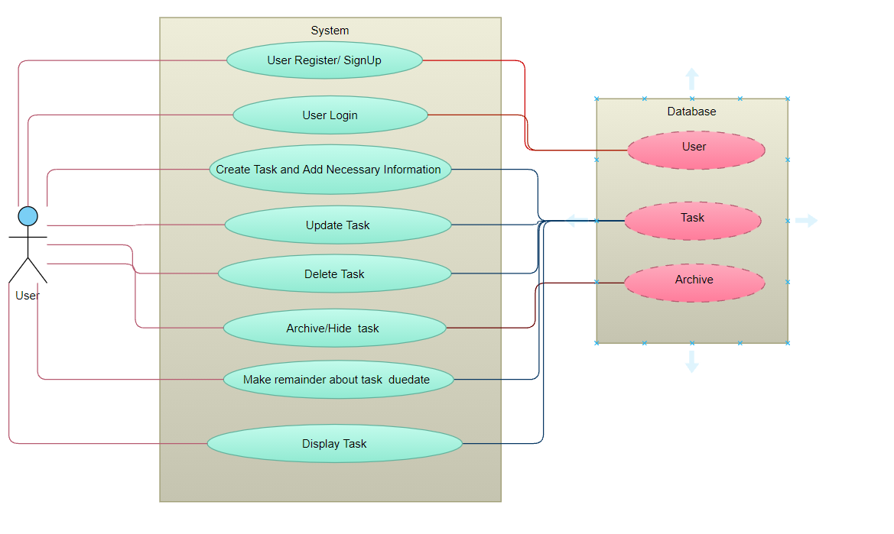
Use Case Diagram

Slide 6
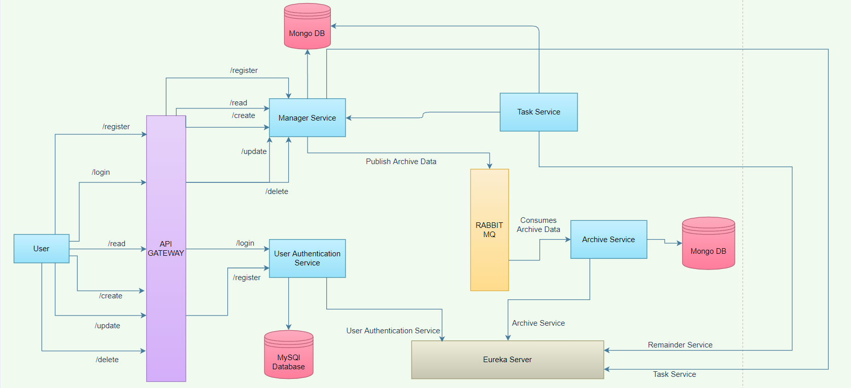
Architecture Diagram

Slide 7
Future Enhancement
Now we are allowing user to login by registered email id. In future we can allow user to login through Google account or other social media accounts.
We can allow user to add images to task and add check lists.
We can allow user to change or reset their password.
We can send confirmation message for new user registration.

Slide 8
Thank You…

